Slide 1
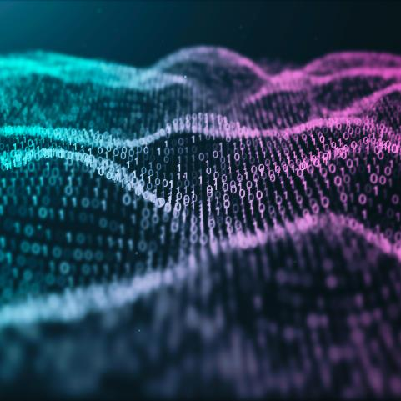
RemoteTouch: Enhancing Immersive 3D Video Communication with Hand Touch
Authors:
Yizhong Zhang, Zhiqi Li, Sicheng Xu, Chong Li, Jiaolong Yang k, Xin Tong, Baining Guo

Slide 2
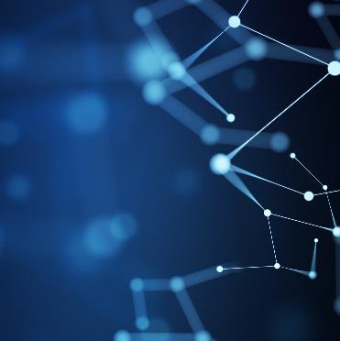
Content:
Section 1: Introduction
Section 2: Motivation
Section 3: Background and Related Work
Section 4: Methods
Section 5: Conclusion

Slide 3
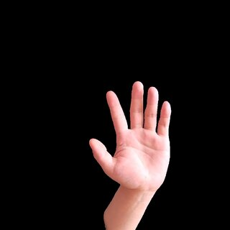
Introduction
WHAT IS REMOTETOUCH?
Enhancing 3D Video Communication: RemoteTouch aims to improve remote meeting experiences by simulating the presence of participants in the same room.
Replicating In-Person Interaction: The technology captures essential nonverbal cues including:
Facial expressions
Body gestures
Physical touch
Focus on Physical Touch: Recognizes touch as a vital, yet often missing, element in remote communication.
Virtual Hand Touch: Participants can 'feel' and respond to each other's touch, thanks to a virtual overlay that mimics physical interaction.
Lifelike Communication: The result is an immersive environment that closely mirrors face-to-face interaction, making digital communication more natural and engaging.

Slide 4
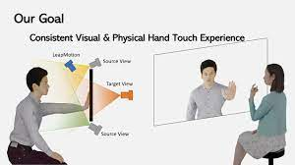
Motivation
Bridging the Gap: Addressing the lack of physical touch in current 3D video communication systems.
Importance of Touch: Recognizing physical touch as a critical nonverbal communication element in social interactions.
Enabling Remote Touch: Introducing the capability for remote participants to experience hand touch.
Enhancing Communication: Aiming to improve the overall experience of remote communication.
Reducing Mental Distance: Helping to minimize the psychological separation felt during remote interactions.

Slide 5
Background And Related Work
Shared Tabletop Scenarios: Previous methods focused on capturing hand gestures for collaboration over a shared digital tabletop.
Shared Whiteboard Scenarios: Techniques were developed for remote collaboration using large displays as interactive whiteboards.
Limitations of Past Methods:
Struggled with rendering hands when close to screens.
Inconsistent touch experiences when hands interacted with digital displays.

Slide 6
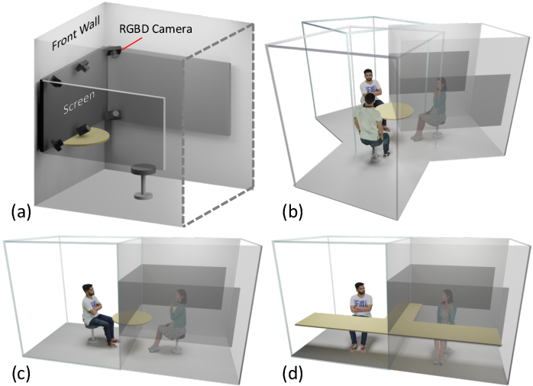
METHODS
The first component of the dual representation is the image-based model. This model uses RGBD data from cameras installed around the display to render a high-quality image of the hand.
It leverages advanced depth sensing and deep learning techniques to achieve real-time rendering. The image-based model is used when the hand is visible to the cameras and provides photorealistic results.
The second component is the 3D geometry-based model. This model tracks the movement of the hand skeleton, including the arm and fingers, using a sideview camera. It then rigs the resulting skeleton to a pre-defined hand mesh model.
The 3D geometry-based model is used when the hand is completely invisible to the cameras, such as when it touches the screen.
While the rendering quality of this model may be inferior to the image-based model, it provides a realistic substitute in situations where the hand is not visible.

Slide 7
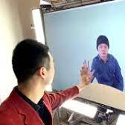
METHODS
To seamlessly blend the two models, a distance-based fusion algorithm is employed. This algorithm determines the weights given to each model based on the distance between the hand and the display. When the hand is far from the screen, the image-based model is primarily used for rendering. As the hand moves closer to the screen, the geometry-based model gains more weight in the rendering process. When the hand is completely invisible to the cameras, the geometry model takes full control. This fusion process ensures a smooth transition between the two models as the hand approaches or touches the screen.
Additionally, the system includes touch emulation to provide a physical experience of hand touching. The screen itself serves as the physical medium for hand contact. When two users reach out their hands to the screens, the system detects mutual hand touch and triggers a vibration motor attached to the display. This provides physical feedback to mimic the feeling of hand clapping.

Slide 8
Results
Experiments were conducted to evaluate the system. The dual representation and fusion algorithm generated convincing rendering results at different distances from the screen.
Users reported an enhanced immersive experience and decreased mental distance between remote participants.
The addition of haptic feedback in the form of screen vibration further improved the sense of touch during hand clapping.

Slide 9
Conclusion
In conclusion, the RemoteTouch system provides an innovative solution for enhancing the immersive experience of 3D video communication by emulating hand touch between remote participants.
The method's dual representation and fusion algorithm successfully render realistic and seamless hand touch experiences.
While there are limitations to be addressed, the system shows great potential for improving remote communication and reducing the sense of distance between users.

Slide 10
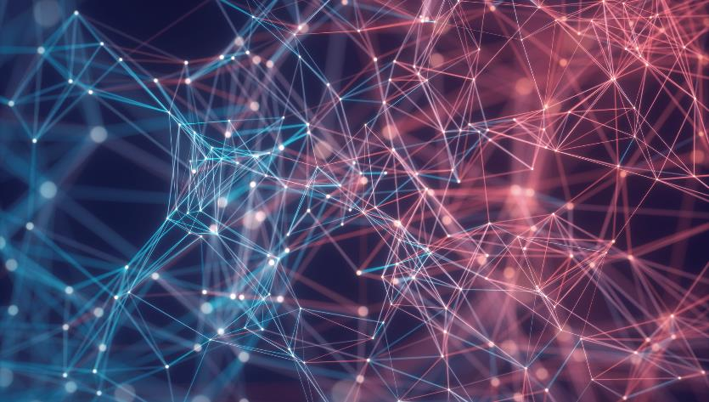

Thank You

Slide 11
Any Questions?

